Slide 1
HealthConnectPro Patient Portal
CS691 FALL 2023 PROJECT TEAM
Kelly Liu
Nikhil Bhosale Bhau
Tiara Hammond
Mukesh Laudya
Kamesh Nalla
Nikhil Kumar Ratakonda
Vivek Vinay Somani
Dhanusha Veluvolu

Slide 2
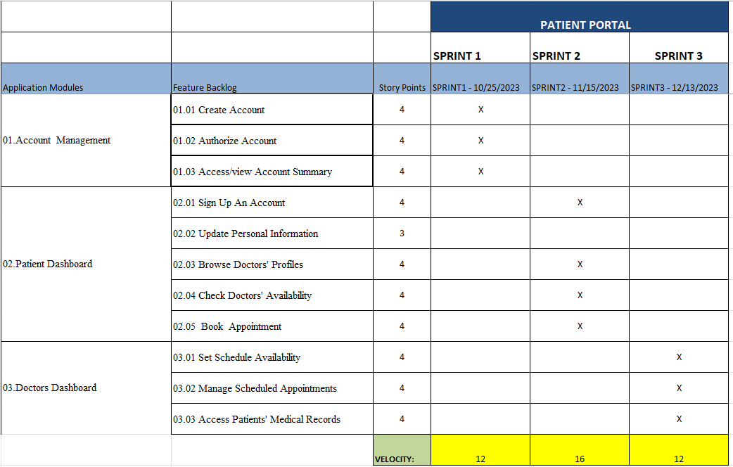
Road Map – (Mukesh Laudya)

Slide 3
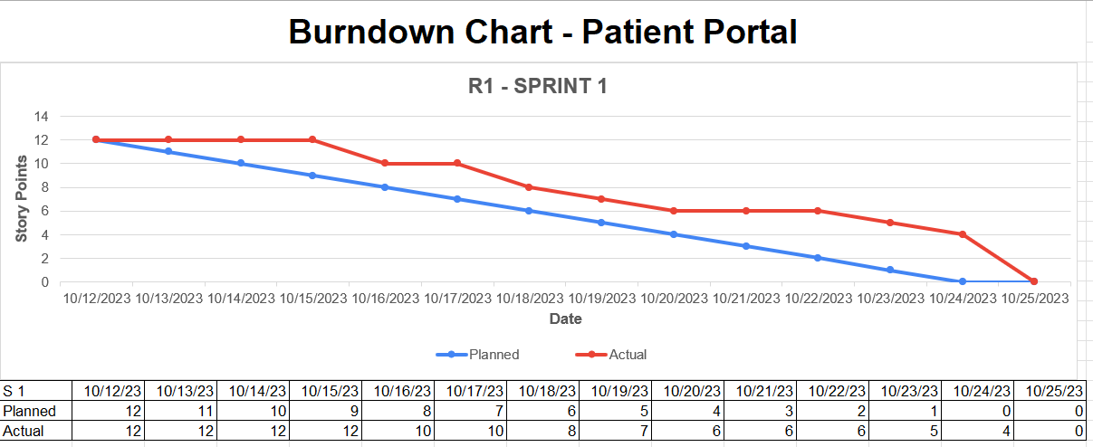
Burn Down Chart - (Mukesh Laudya)
SPRINT 1

Slide 4
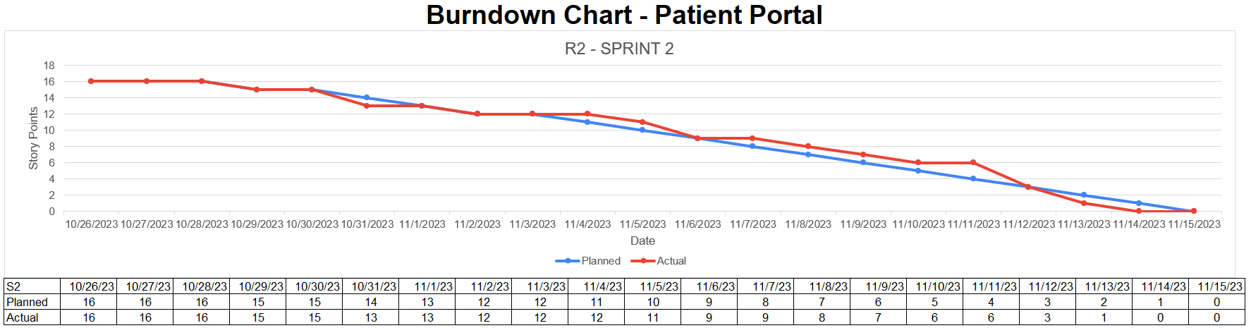
Burn Down Chart - (Mukesh Laudya)
SPRINT 2

Slide 5
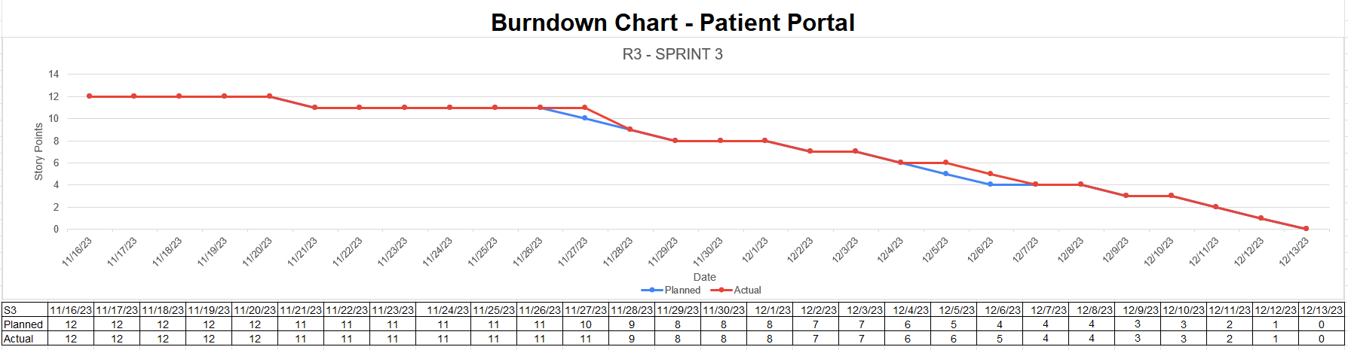
Burn Down Chart - (Mukesh Laudya)
SPRINT 3

Slide 6
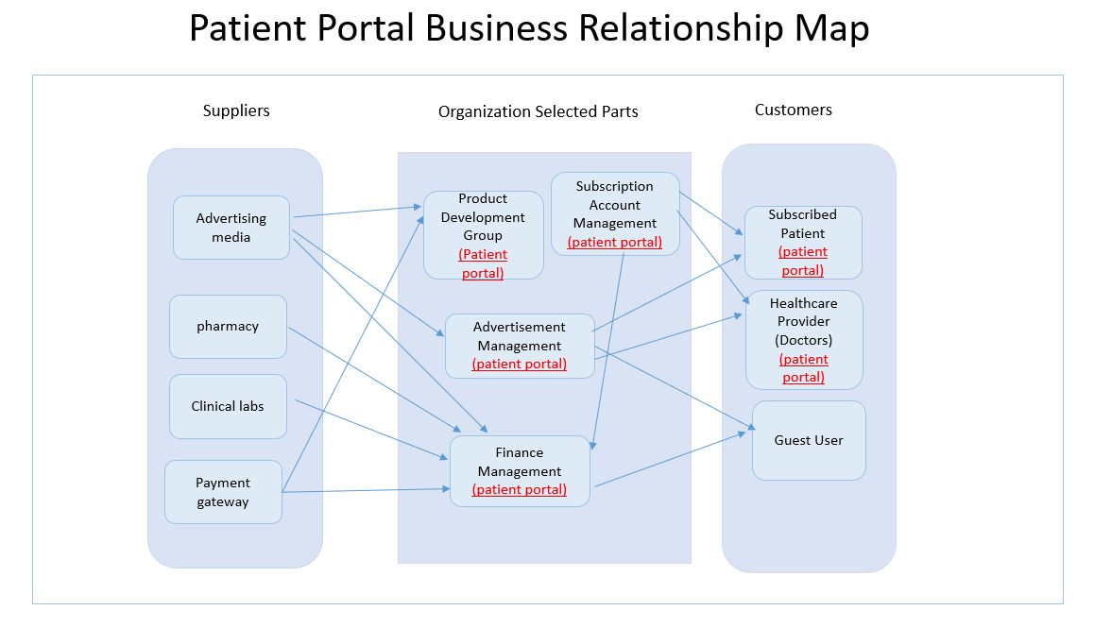
BRM (Dhanusha Veluvolu)

Slide 7
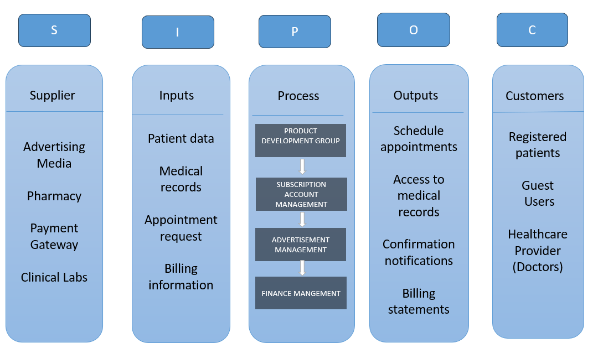
SIPOC Diagram (Dhanusha Veluvolu)

Slide 8
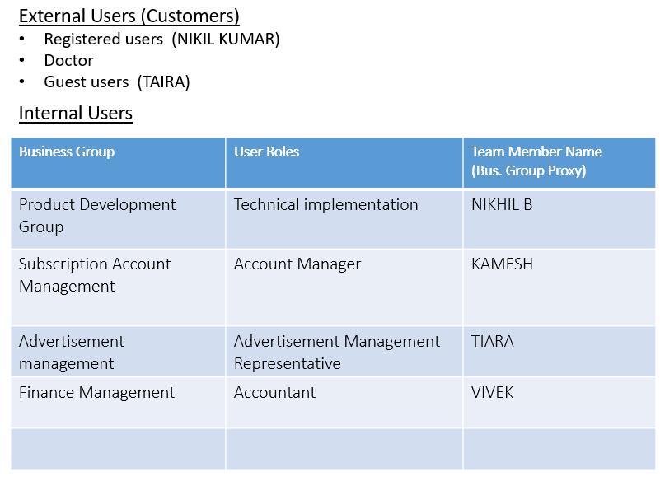
User Roles by Business Group (Dhanusha Veluvolu)

Slide 9
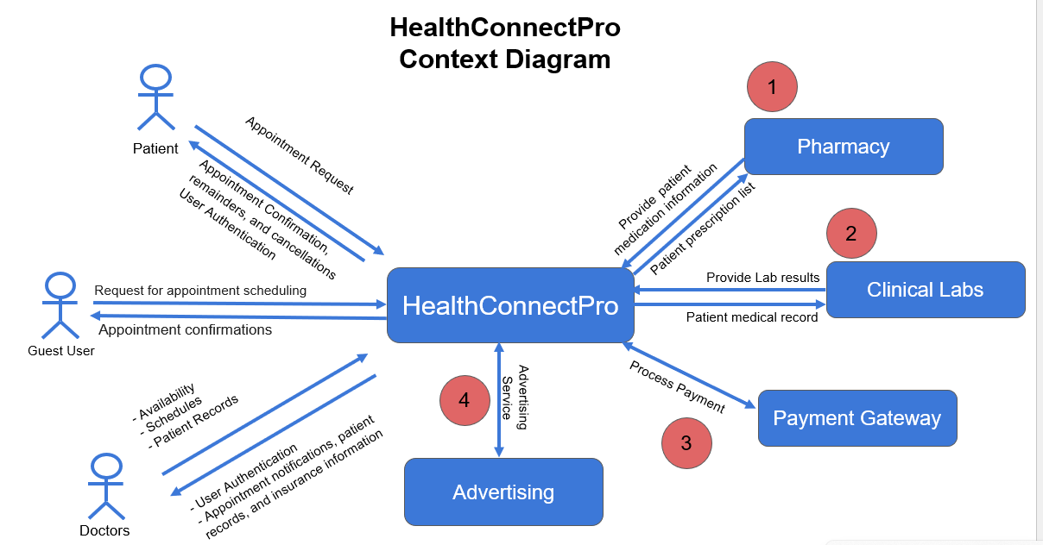
Context_Diagram (Nikhil Kumar)

Slide 10
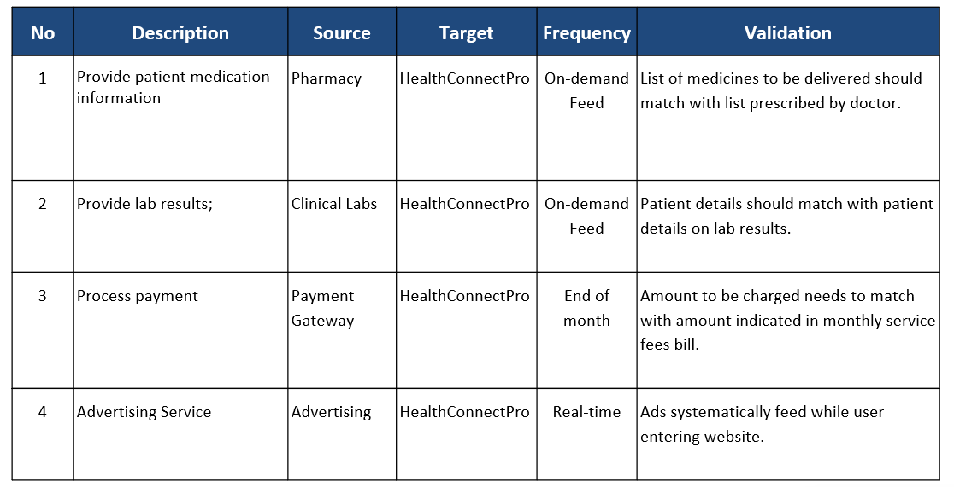
System Interface Table (Nikhil Kumar)

Slide 11
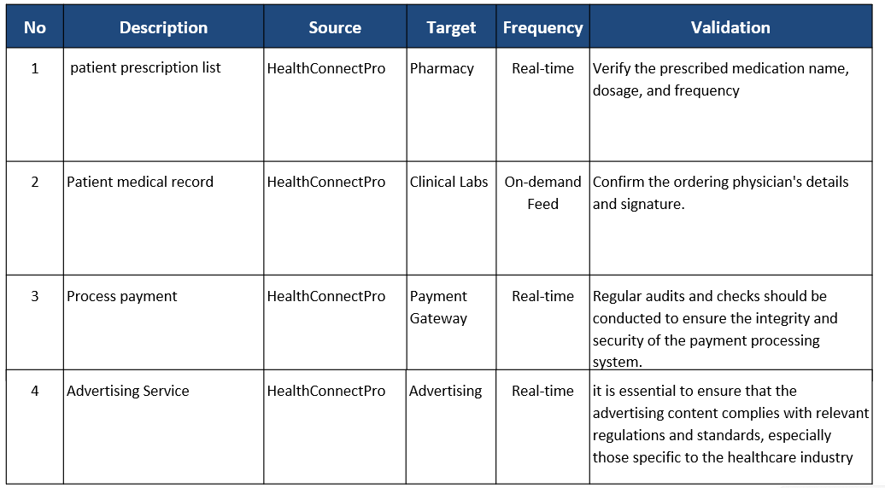
SI-OUT TABLE (Nikhil Kumar)

Slide 12
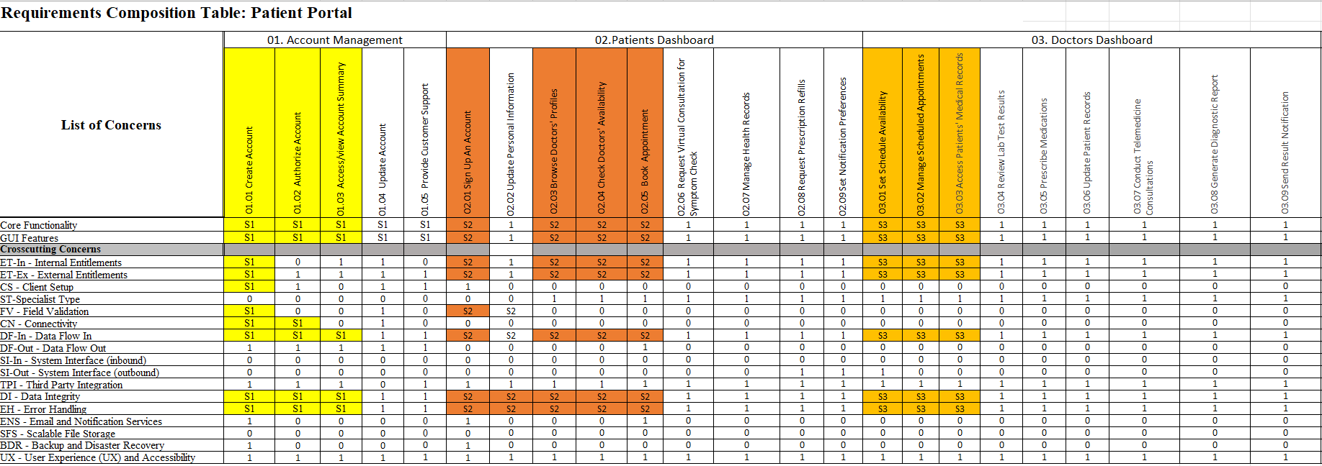
RCT – Kelly liu

Slide 13
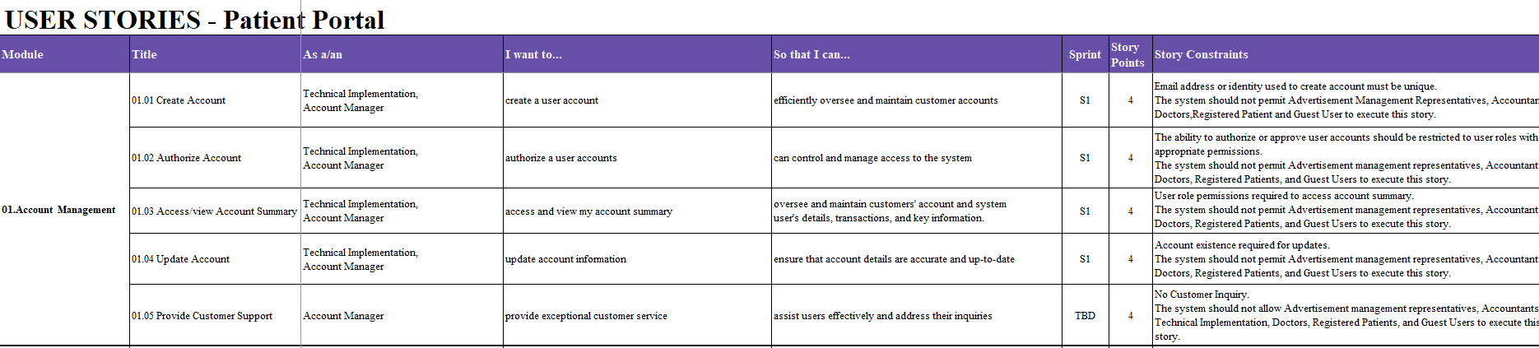
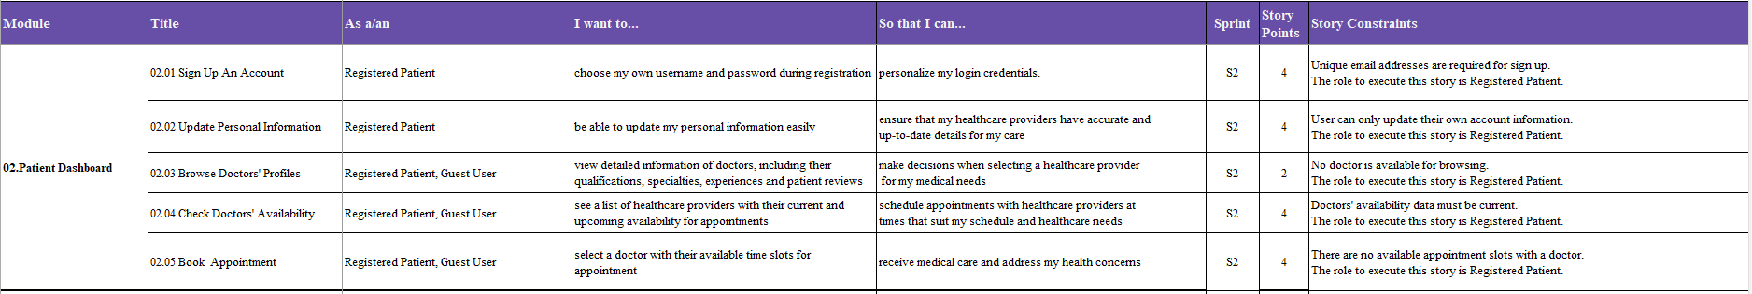
User stories- (Tiara)

Slide 14
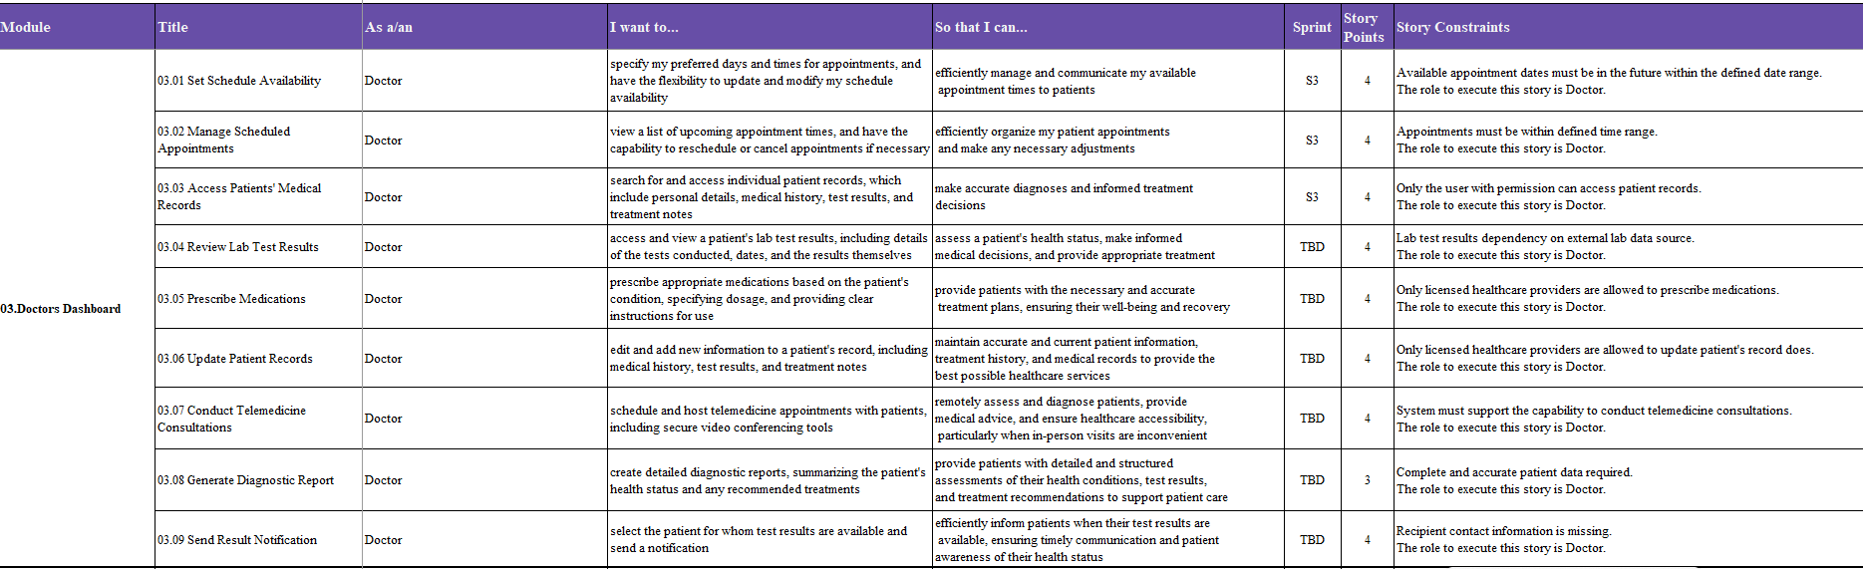
User stories- (Tiara)

Slide 15
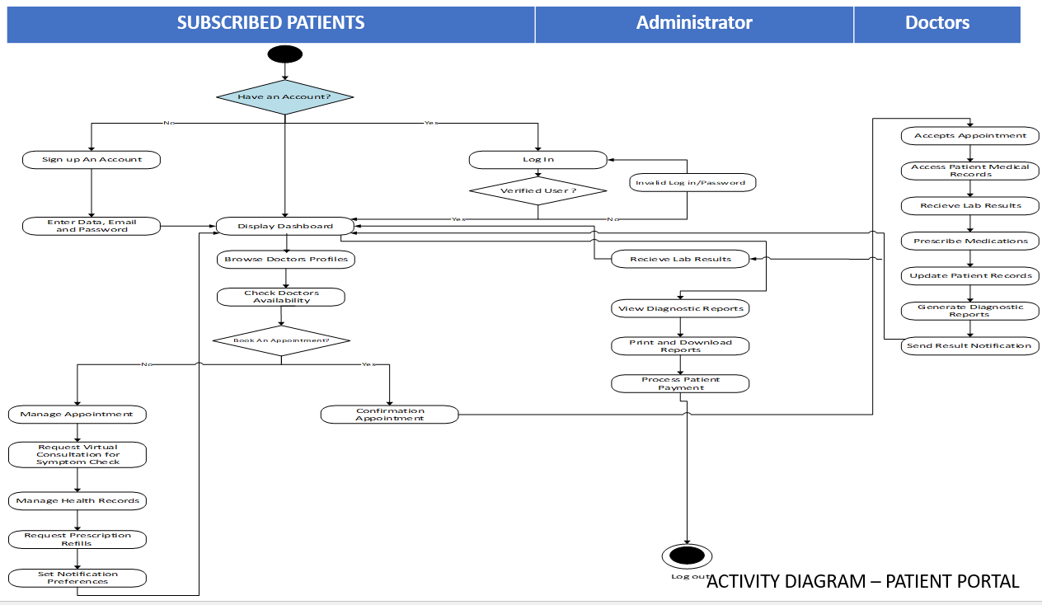
UML Activity Diagram (Vivek Vinay Somani)

Slide 16
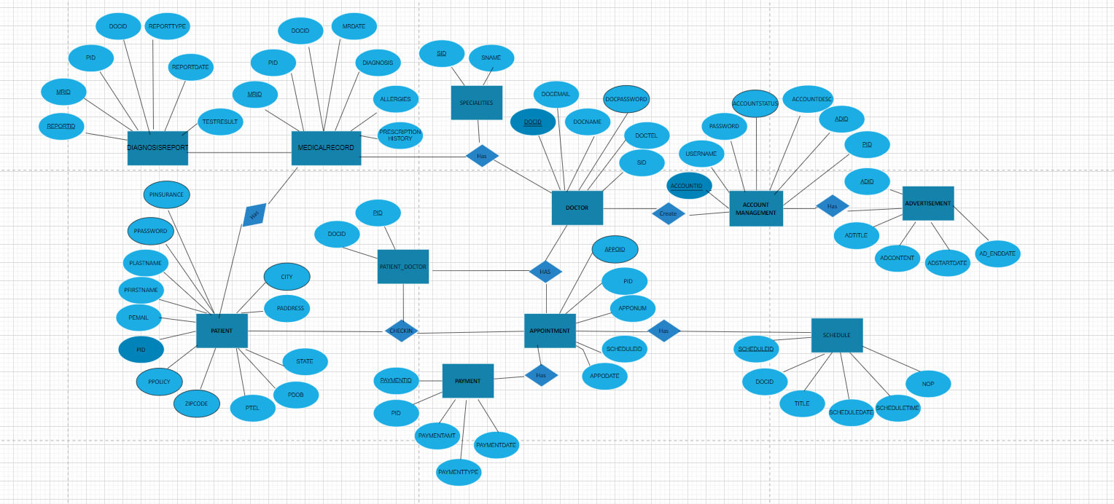
Conceptual ER DIAGRAM (Kamesh Nalla)

Slide 17
logical ER DIAGRAM (Kamesh Nalla)

Slide 18
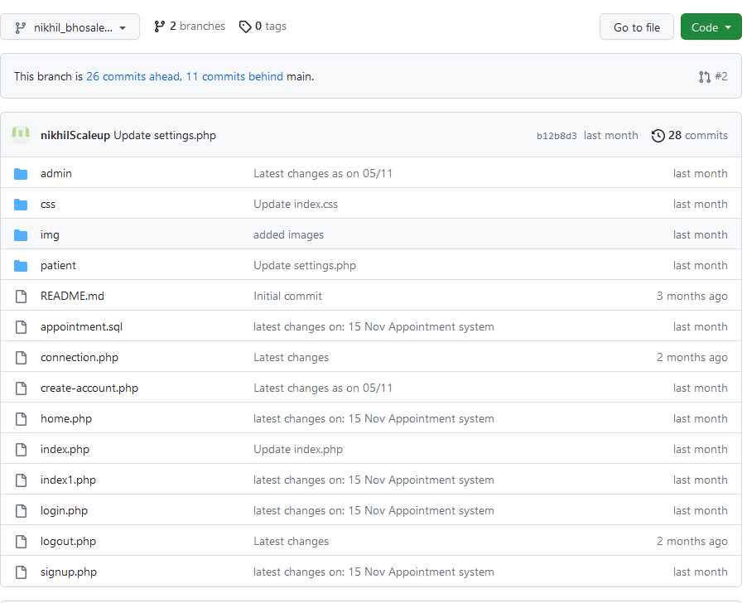
Source Code - Nikhil Bhosale Bhau

Slide 19
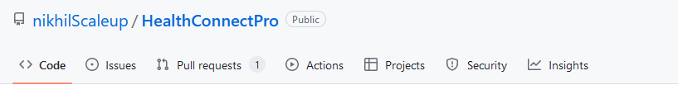
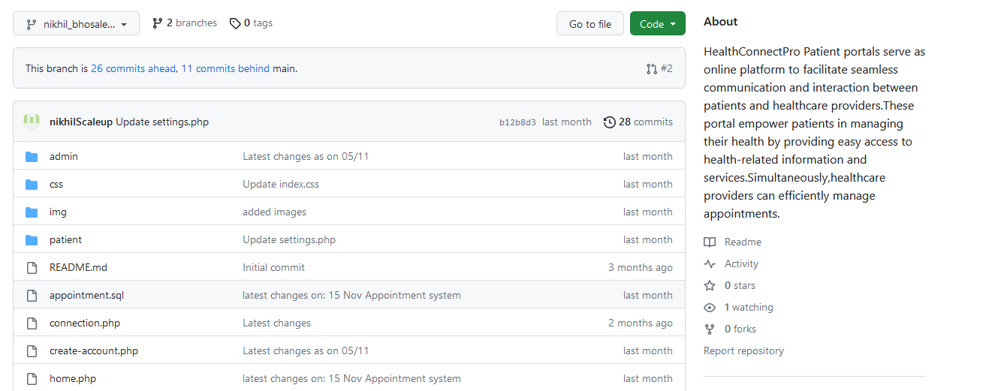
GIThub - nikhil Bhosale Bhau

Slide 20
Jenkins Demo-Kamesh Nalla
JENKINS DEMO
https://drive.google.com/drive/u/1/folders/1yFDxe4HmWGRRZGKNQ1Hb-6Ey_nGInHwF?ths=true

Slide 21
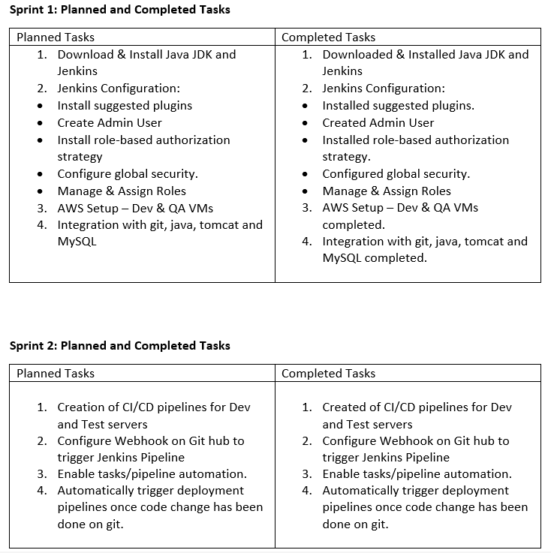
Jenkins progress report (Kamesh Nalla)

Slide 22
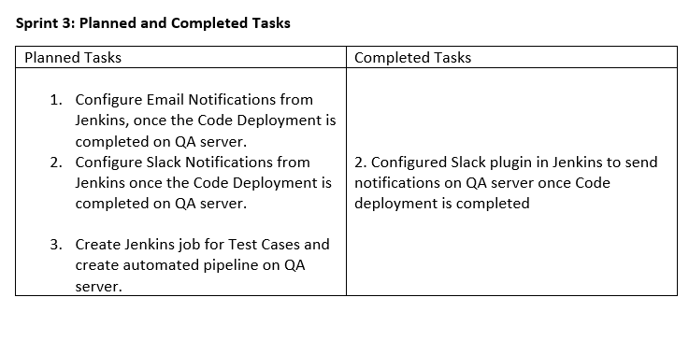
Jenkins progress report (Kamesh Nalla)

Slide 23

Application Demo (Nikhil Bhau)
Home Page

Slide 24
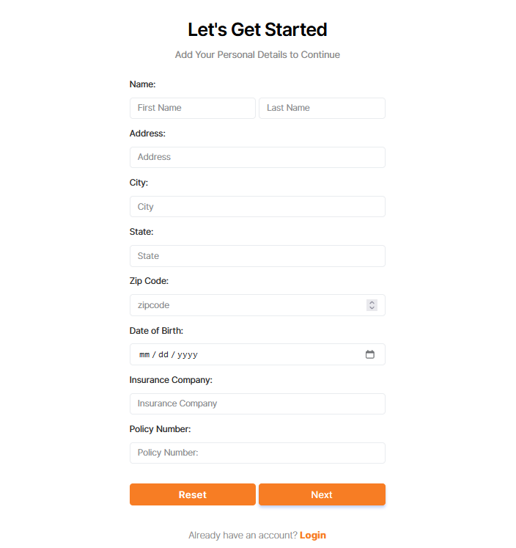
Application Demo (Nikhil Bhau)
Sign Up Page

Slide 25
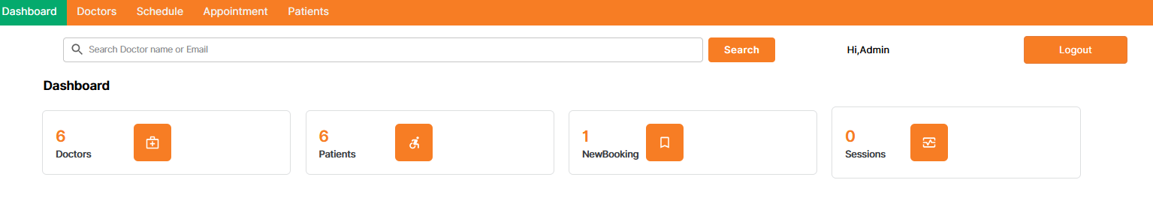
Application Demo (Nikhil BHAU)
Admin Dashboard

Slide 26
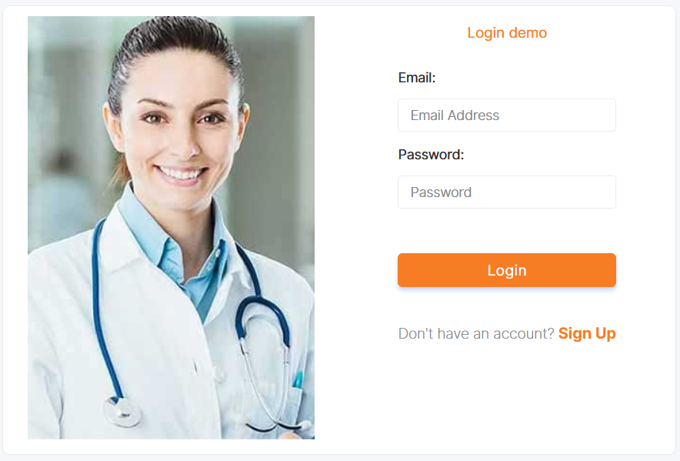
Application Demo (Nikhil Bhau)

Slide 27
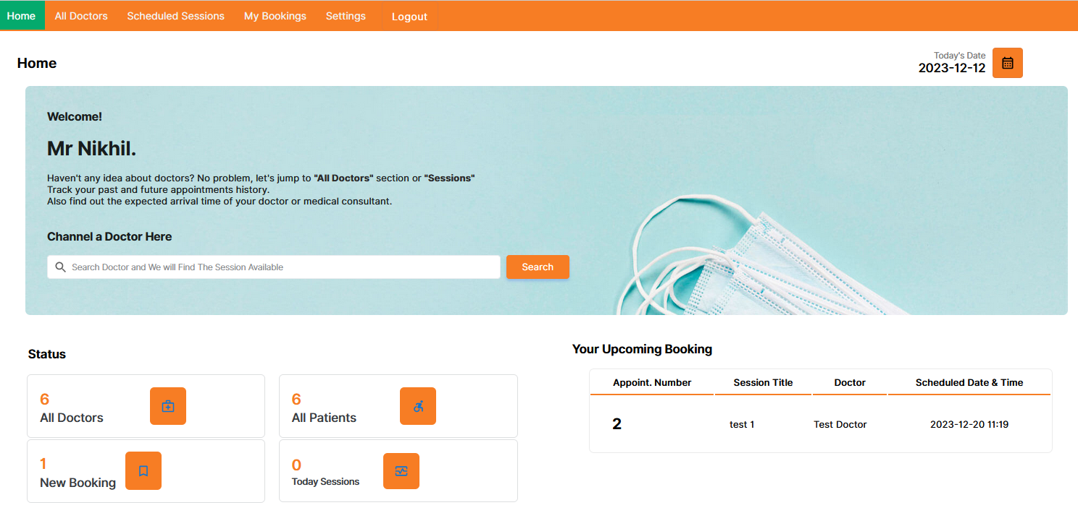
Application Demo (Nikhil Bhau)
Patient Dashboard

Slide 28
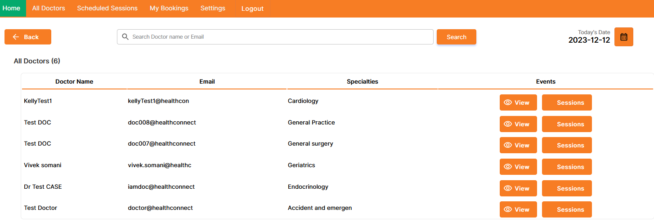
Application Demo (Nikhil Bhau)
Patient Dashboard

Slide 29
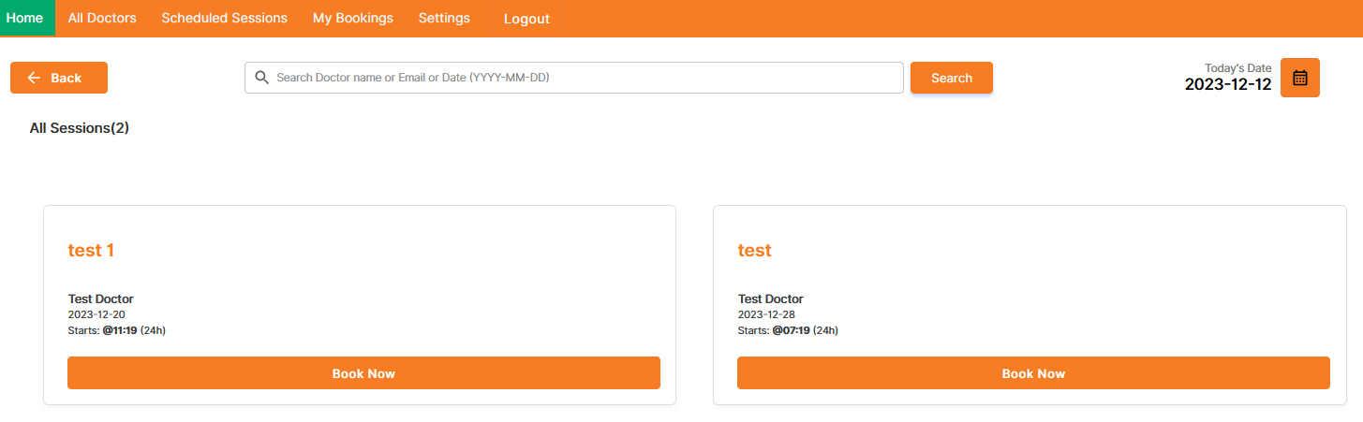
Application Demo (Nikhil Bhau)
Patient Dashboard

Slide 30
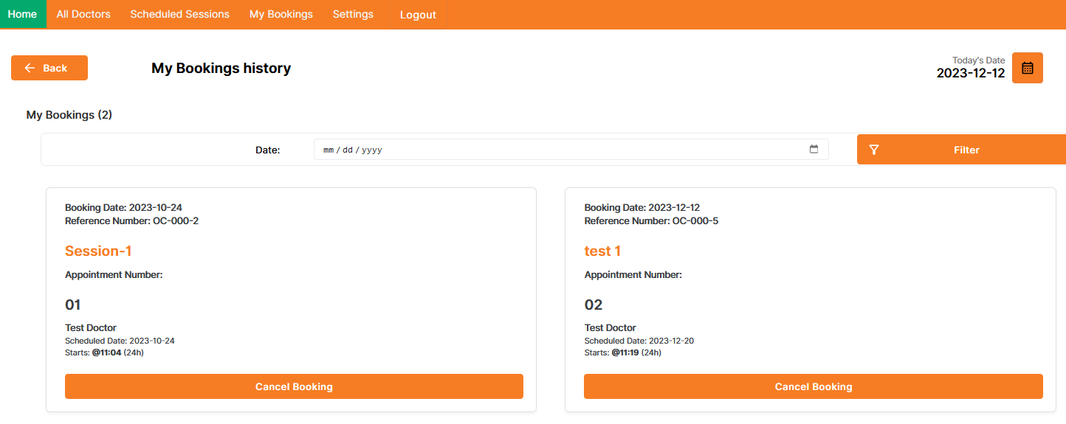
Application Demo (Nikhil Bhau)
Patient Dashboard

Slide 31
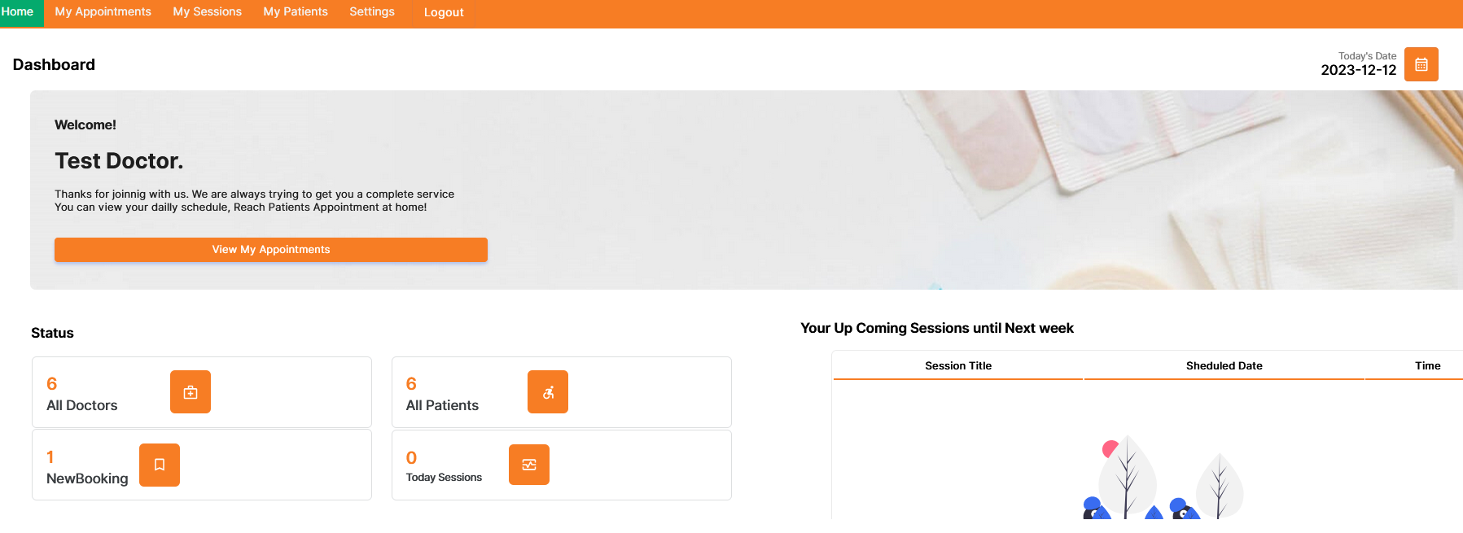
Application Demo (Nikhil Bhau)
Doctor Dashboard

Slide 32
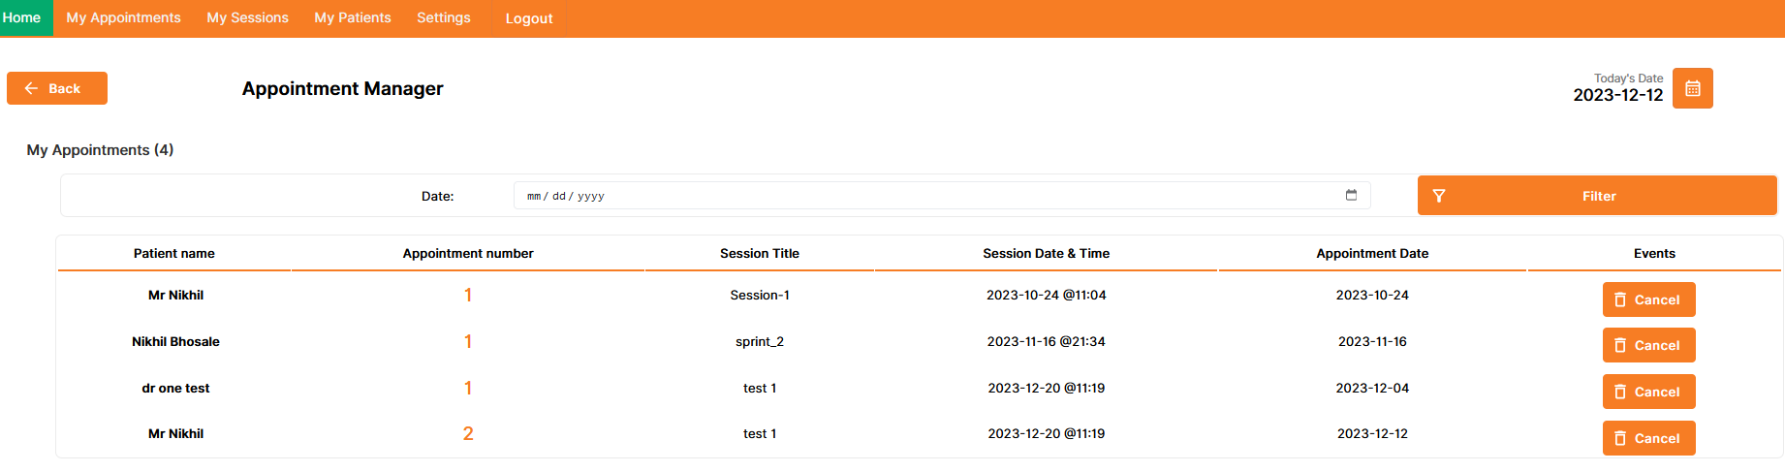
Application Demo (Nikhil Bhau)
Doctor Dashboard

Slide 33
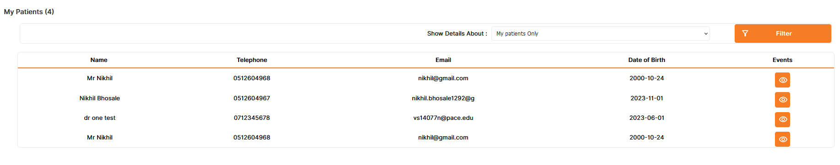
Application Demo (Nikhil Bhau)
Doctor Dashboard

